Slide 1
Data Structures and Algorithms(CSE2001)
MODULE 1
Introduction to Data Structure and Linear Data Structure
1-<number>

Slide 2
Introduction
What are Data Structures?
Data structures are containers for storing and organizing data in a computer's memory.
They define how data is stored, accessed, and manipulated.
A data structure is a way to store and organize data in order to facilitate access and modifications. No single data structure works well for all purposes, so it is important to know the strengths and limitations of several of them.
1-<number>

Slide 3
Different types of Data Structures
Depending on the organization of the elements, data structures are classified into two types:
Linear data structures: Elements are accessed in a sequential order but it is not compulsory to store all elements sequentially (say, Linked Lists).
Examples: Linked Lists, Stacks and Queues.
Non – linear data structures: Elements of this data structure are stored/accessed in a non-linear order.
Examples: Trees and graphs.

Slide 4
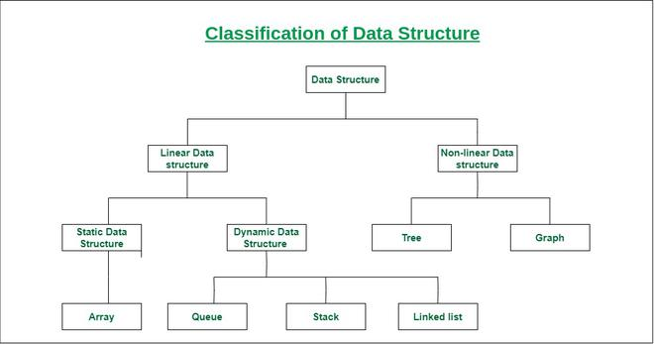

Slide 5
Abstract Data Type(ADT)
Abstract data type: is a collection of data and the operations that can be performed on the data. In the extreme, the data that comprise the ADT are not directly accessible from the outside. When implemented in this manner, the only way to get at the data (or modify it) is through the defined operations on the ADT.

Slide 6
Abstract Data Type
Computer programs also need to organize their data.
  Examples: a list, a stack, a dictionary, and etc..
An abstract data type, or ADT:
  A specification that describes a data set and the operations on that data.
  Each ADT specifies what data is stored and what the operations on the data do.
  An ADT does not indicate how to store the data or how to implement the operations
Notes:
Copyright ©2011 by Pearson Education, Inc. All rights reserved

Slide 7
Overview of Java

Slide 8
Introduction
Java is a computer programming language.
Java was created based on the C & C++. Java uses C syntax and many of the object oriented features are taken from C++.
Before Java was invented there were other languages like COBOL, FORTRAN, C, C++, Small Talk etc., These languages had few disadvantages which were corrected in Java
Java also innovated many new features to solve the fundamental problems which the previous languages could not solve.

Slide 9
Features of Java
- Simple
- Object Oriented
- Robust
- Multi Threading
- Architecture Neutral
- Interpreted and High Performance
- Distributed
- Dynamic

Slide 10
Java is an Object-Oriented Language. Java supports the following fundamental concepts −
Polymorphism
Inheritance
Encapsulation
Abstraction
Classes
Objects
Instance
Method
Message Passing

Slide 11
BASICS OF JAVA

Slide 12
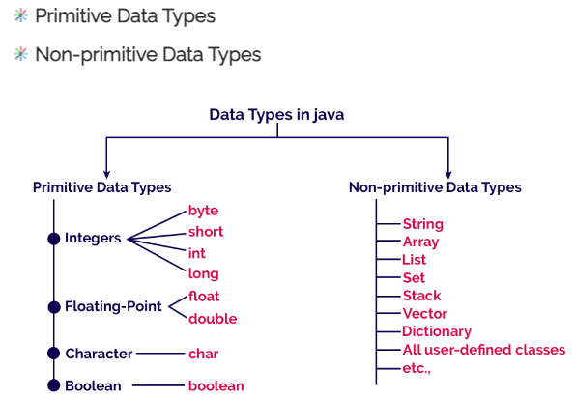
Java Data types

Slide 13
Primitive Data types
Base Types:
boolean a boolean value: true or false
char 16-bit Unicode character
byte 8-bit signed two’s complement integer
short 16-bit signed two’s complement integer
int 32-bit signed two’s complement integer
long 64-bit signed two’s complement integer
float 32-bit floating-point number (IEEE 754-1985)
double 64-bit floating-point number (IEEE 754-1985)

Slide 14
Declarations and initializations of several base-type variables.
1 boolean flag = true;
2 boolean verbose, debug; // two variables declared, but not yet initialized
3 char grade = 'A';
4 byte b = 12;
5 short s = 24;
6 int i, j, k = 257; // three variables declared; only k initialized
7 long l = 890L; // note the use of ”L” here
8 float pi = 3.1416F; // note the use of ”F” here
9 double e = 2.71828, a = 6.022e23; // both variables are initialized

Slide 15
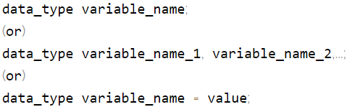
Java Variables
In java programming language, variables are classiffied as follows.
Local variables
Instance variables or Member variables or Global variables
Static variables or Class variables
Final variables
Syntax to declare variables:

Slide 16
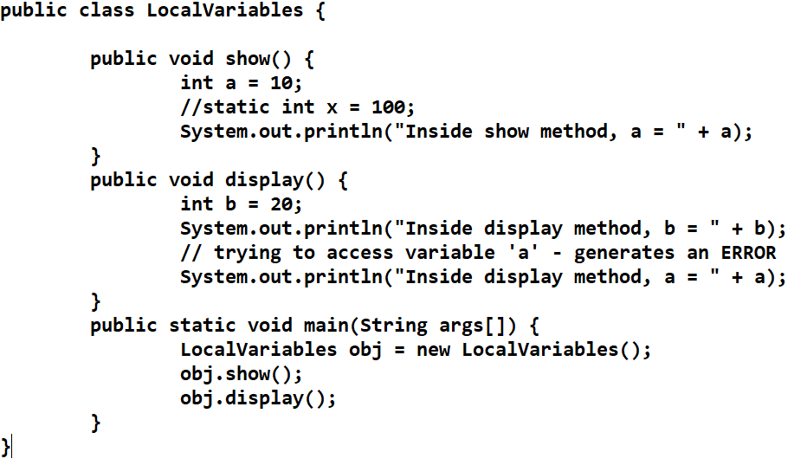
Java code to demonstrate local variables visibility

Slide 17
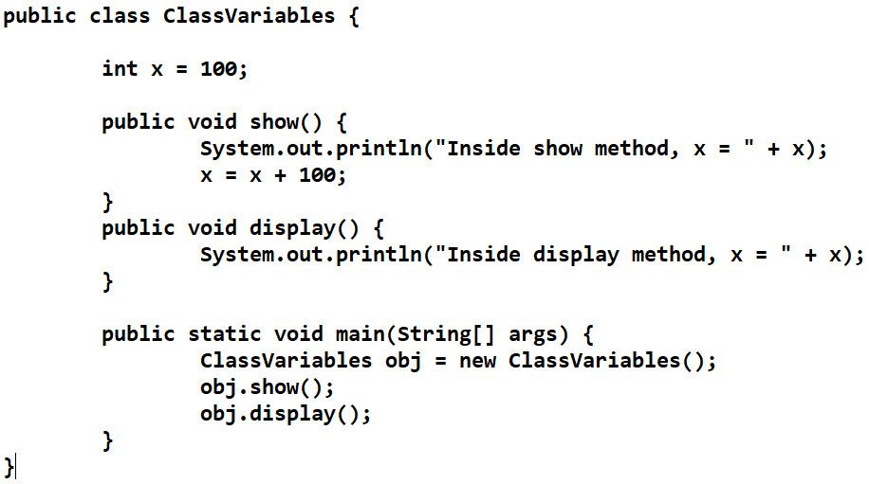
Java program to illustrate instance or global variable.

Slide 18
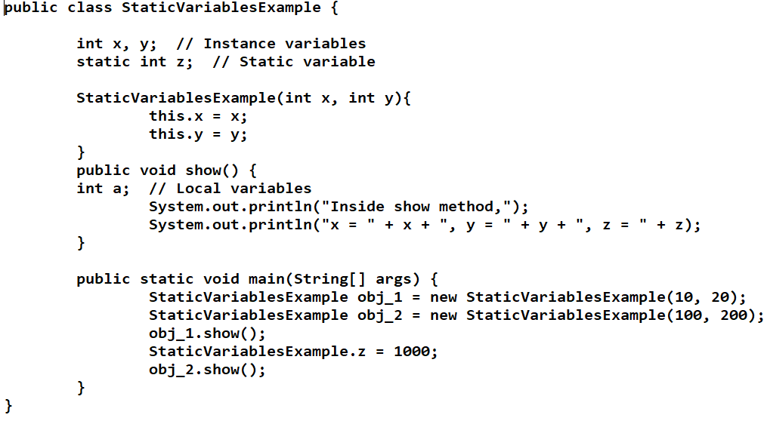
Java program to illustrate static variable

Slide 19
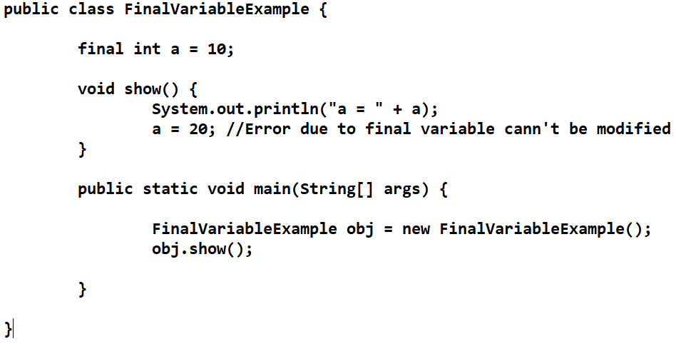
Java program to illustrate final variable

Slide 20
Classes in Java

Slide 21
Introduction
The entire concept of Object Oriented Programming is not about objects, its about class. Because we use classes to create objects…..
The class describes what an object will be. It’s a blue print of an object and it is the description and definition of an object.

Slide 22
How to Create a class?
To create a class first, we need to find the following….
Name -
type
What is it ?
Student, Employee, BankAccount, Document, Car, Box…..
Attributes -
Properties, data
What describes it ?
name, salary, balance, size, color, width…..
Behavior -
operations
What can it do ?
read, play, search, save, create, print, close, open, deposit…..

Slide 23
Example class
Creating a Bank Account class
Name -
BankAccount
Attributes -
name, AccNo, balance, dateOpened, accountType, branch
Behavior -
open( ), close( ), deposit( ), withdraw( )

Slide 24

Example class
A class is represented in a rectangle box with 3 rows..
ClassName
Asha
54321
1800
3/6/2013
Savings
HYD
open()
close()
deposit()
withdraw()
Jayasree
67894
15000
23/5/2014
Current
Sec’bad
open()
close()
deposit()
withdraw()
BankAccount
Rahul
12345
1500
3/5/2014
Savings
Sec’bad
open()
close()
deposit()
withdraw()
Creating objects is called instantiation
name
accountNumber
balance
dateOpened
accountType
branch
List
Of
Attributes
.
.
List
Of
Operations
.
.
open( )
close( )
deposit( )
withdraw( )
RahulAcct
AshaAcct
JayaAcct
class
Object (instance)

Slide 25
Creating object of a class
Syntax for object creation
class BankAccount
ClassName objectName = new ClassName( );
BankAccount
class BankAccount
{
  String name ;
  int accountNumber;
  double balance ;
  String dateOpened;
  String accountType;
  String branch;
name
accountNumber
balance
dateOpened
accountType
branch
{
  String name ;
  int accountNumber;
  double balance ;
  String dateOpened;
  String accountType;
  String branch;
Example for object creation
BankAccount rahulAcct = new BankAccount( );
  void open( ){….}
  void close( ){….}
  void deposit( ){….}
  void withdraw( ){….}
BankAccount ashaAcct = new BankAccount( );
open( )
close( )
deposit( )
withdraw( )
  void open( ){….}
  void close( ){….}
  void deposit( ){….}
  void withdraw( ){….}
BankAccount jayaAcct = new BankAccount( );
  }
  }

Slide 26
ARRAYS in JAVA

Slide 27
Array is collection of related data items
Creating an array
  Declare an array
  Create memory location
  Putting values to memory locations

Slide 28
Declaring an Array Variable
Do not have to create an array while declaring array variable
  <type> [ ] variable_name;
  double[ ] myList;
  double myList[ ];
Both syntaxes are equivalent
No memory allocation at this point

Slide 29
Defining an Array
Define an array as follows:
  variable_name=new <type>[arraySize];
  Number = new int[5];
  Mylist = new int[10];
It creates an array using new dataType[arraySize];
It assigns the reference of the newly created array to the variable variable_name.
dataType arrayname[ ] = {list of values};
int a [ ]={1,2,3,4,5,6,7};
Array index starts from 0 to arraySize-1;
int is of 4 bytes, total space=4*10=40 bytes
Declaring and defining in the same statement:
  double [ ] mylist = new double[10];

Slide 30
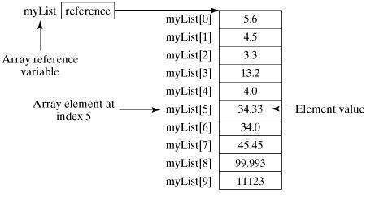
Creating arrays cntd...

Slide 31

Example: Ms. White's Test Score Analyzer
Problem:
Ms. White needs to analyze
students' test performance.
She needs a program to
display a name and let
her enter the test score. Then it should compute and display the average. Finally it should give a report with names, scores, and deviation from the average.

